Slide 1

Predicting Business Innovation in the Pharmaceutical Industry
NSF NCSES
DSPG 2019

Slide 2
Introduction
Sponsors:
Michelle Gregory, Fairfax County Health and Human Services
Sophia Dutton, Fairfax County Health and Human Services
Kathi Huddleston, Inova Translational Medicine Institute
Sahel Hazrati, Inova Translational Medicine Institute
Grace Lawrence, Inova Translational Medicine Institute
Motivation:
Determine factors that influence obesity in Fairfax County by investigating where residents live, learn, work, and frequent
Ultimate goal: creation of informed policy

Slide 3
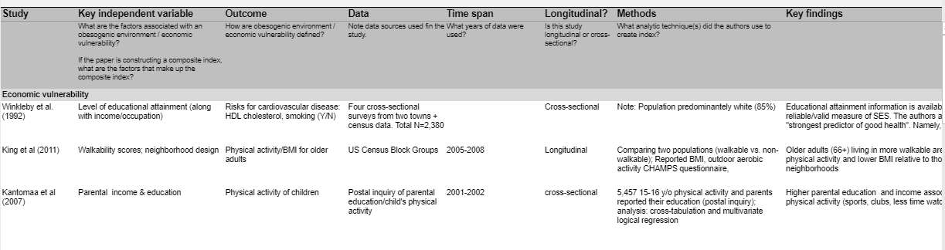
Literature Review
Insights:
-Parental education/income & physical activity
-Walkability scores and physical fitness
-

Slide 4

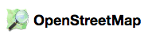

Process
Data
Creation of composite indices
Collection of related, weighted variables that impact an identified **issue
Chosen composite indices:
Economic Vulnerability
Obesogenic Environments
American Community Survey data
Synthetic data
Fairfax County Housing Stock
Open Street Maps data
Source: census.gov
Source: Open Street Map
Source: fairfaxcounty.gov
Notes:
Explanation of composite indices
Creation of composite indices for the purpose of quantitatively contextualizing social determinants of health and wealth that impact resident's risk of obesity
Synthetic data created from ACS block group data

Slide 5
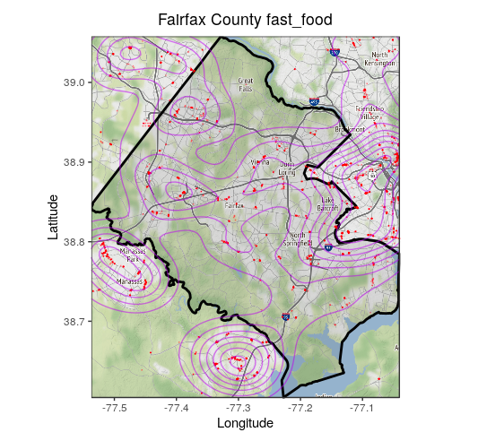
Examples of Data Discovery
OSM Data Discovery: playgrounds in Fairfax County
OSM Data Discovery: fast food in Fairfax County

Slide 6
Indice 1: Economic Vulnerability
Variables (from Census data):
Income
Education
Govt. Supplemental
Fairfax County graphic example

Slide 7
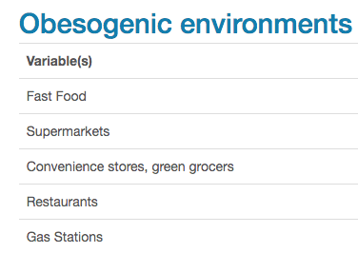
Indice 2: Obesogenic Environments

Slide 8





Looking Ahead
Data
Explore ACS synthetic data
Join multiple sources
ACS, Housing, OSM
Create travel-time distance
F1
https://www.tidyverse.org
Index Construction
Dimensional/Factor Analysis
Weighting & Aggregation
Interactive Visualization
F2
I
Fn

